Slide 1

Vocabulary Building

Slide 2
Objective: To enable the students expand their vocabulary so as to enhance their proficiency in reading and listening to academic texts, writing and speaking.

Slide 3
WORD FORMATION PROCESS
COMPOUNDING
CLIPPING
BLENDING
DERIVATION
CREATIVE RESPELLING
COINING WORDS
BORROWING WORDS

Slide 4

COMPOUND Words
The process of combining two or more words to form a new word.

Slide 5
COMPOUND Words
Closed compound words are formed when two unique words are joined together. They don’t have a space between them and they are the type that generally comes to mind when we think of compound words.
For example: water+bed= waterbed, door+knob= doorknob, wall+paper= wallpaper, grand+mother= grandmother, up+side= upside, fire+flies= fireflies, play+things= playthings

Slide 6
COMPOUND Words
Open compound words have a space between the words but when they are read together & a new meaning is formed.
Examples- ice cream, attorney general, post office, grand jury, middle class, full moon, real estate etc...

Slide 7


Slide 8
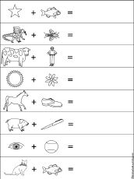
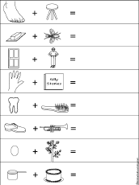

Slide 9
CLIPPING
Definition: Clipped words are words shortened by common use; they are a shortened abbreviation of a word, which makes them easier to spell and write.

Slide 10

CLIPPING
Clip Word | Original Word | Clip Word | Original Word
Ad | Advertisement | margarine | Oleomargarine
alum | Alumni | mart | Market
auto | Automobile | math | Mathematics

Slide 11
CLIPPING
Clip Word | Original Word | Clip Word | Original Word
bike | Bicycle | memo | Memorandum
Lab | Laboratory | mend | Amend
Bro | Brother | mike | Microphone

Slide 12
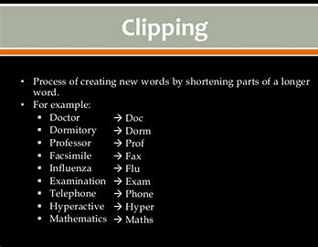

Slide 13
BLENDING
Definition: Blending is the word formation processes in which parts of two or more words combine to create a new word whose meaning is often a combination of the original words.

Slide 14
BLENDING Examples
•advertisement + entertainment → advertainment
•biographical + picture → biopic
•breakfast + lunch → brunch
•chuckle + snort → chortle
•cybernetic + organism → cyborg
•guess + estimate → guesstimate

Slide 15
BLENDING Examples
•hazardous + material → hazmat
•motor + hotel → motel
•simultaneous + broadcast → simulcast
•smoke + fog → smog
•spoon + fork → spork
•telephone + marathon → telethon

Slide 16
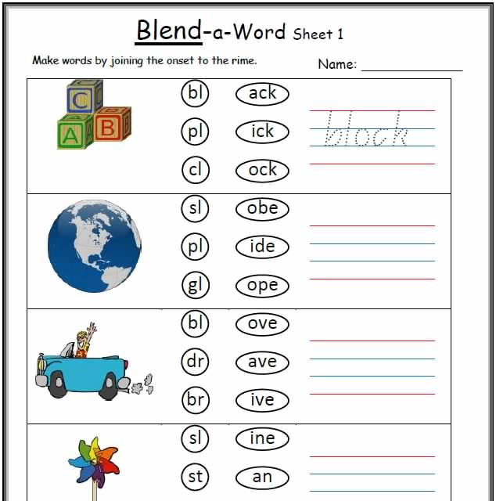
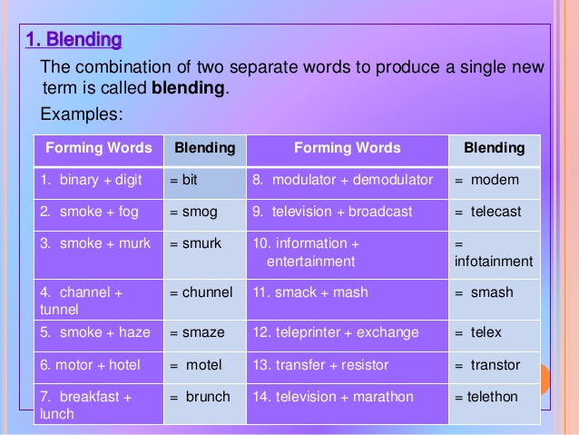
BLENDING Examples

Slide 17
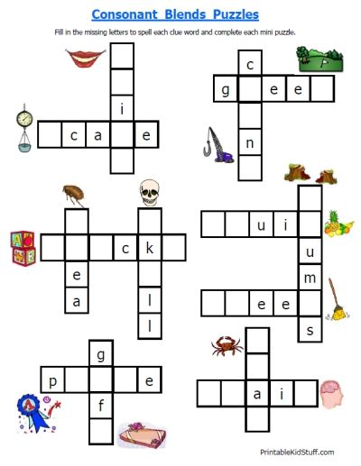

Slide 18
DERIVATION
Definition: Derivation is the process of forming a new word on the basis of an existing word. Examples:
Happiness and unhappy from happy,
drinkable from drink,
modernise from modern,
reddish from red,
personally from personal,
recreational from recreation,
deliverance from deliver,
writer from write

Slide 19
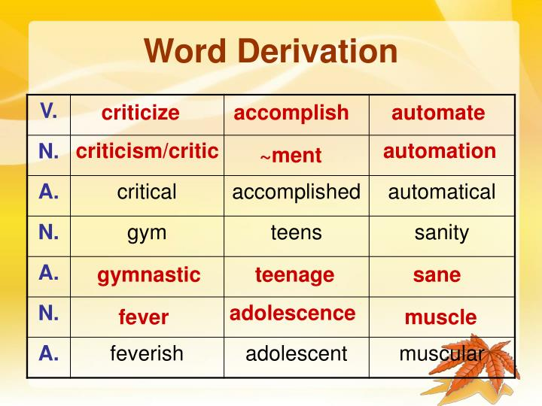

Slide 20
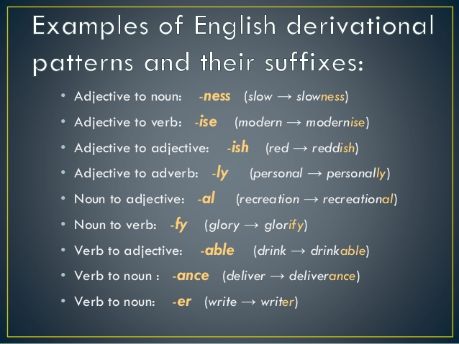

Slide 21
CREATIVE RESPELLING
Definition: Sometimes words are formed by simply changing the spelling of a word that the speaker wants to relate to the new word. Product names often involve creative respelling, such as Mr. Kleen.
Chiefly North American "airplane" is not a respelling but a recoining, modelled after "airship" and "aircraft".

Slide 22
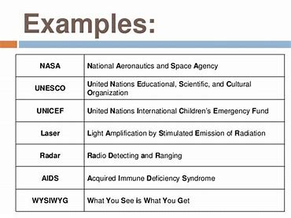

Slide 23
COINING WORDS
Definition: A coined word (or neologism) is a word that has been inspired by a person or event.
Here are a few unique neologisms:
•Metrosexual - a man who dedicates a lot of time and money to his appearance
•Staycation - a vacation at home or near one’s home
•Webinar - online seminar

Slide 24
COINING WORDS
•Banana Republic - politically unstable country that depends on exports
•Butterfingers - clumsy person
•Chortle - chuckle + snort
•Factoid - doubtful fact that has no back-up proof
•Oxbridge = Oxford + Cambridge
•Workaholic - taken from the suffix “-holic” which means addiction
•Yahoo - primitive people with materialistic ways of thinking

Slide 25
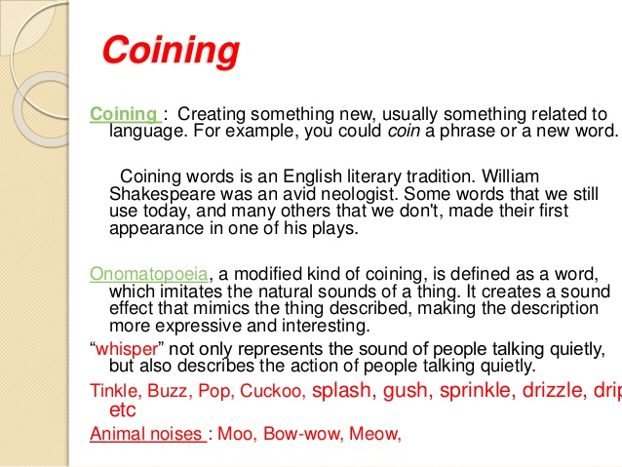

Slide 26
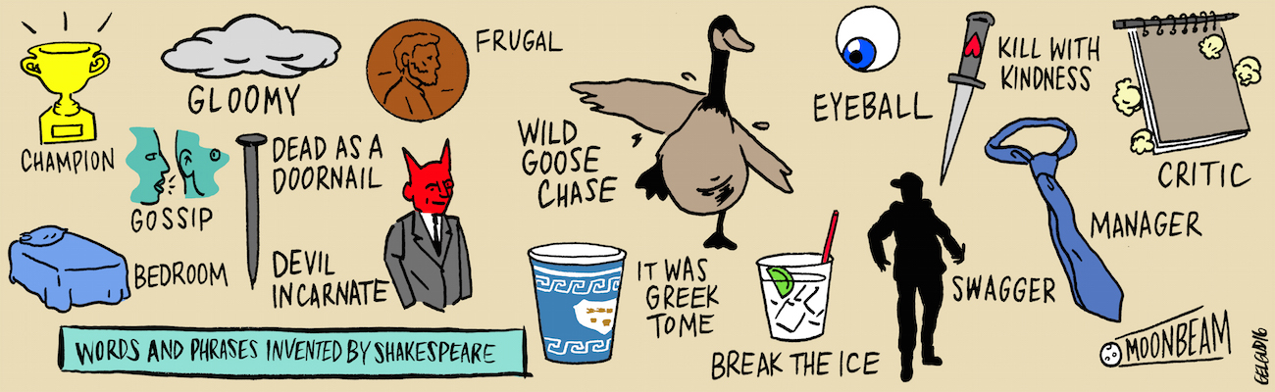

Slide 27
BORROWING WORDS
Definition: Loanwords are words adopted by the speakers of one language from a different language (the source language).
1. ANONYMOUS (GREEK)
The word ‘anonymous’ comes from the Greek word ‘anōnumos’. Anōnumos is defined as something or someone without a name, similar to the English meaning which defines the word as someone who does not reveal their identity.
2. LOOT (HINDI)
Pronounced and defined in the exact same manner in English as it is in the origin language Hindi, the word ‘loot’ refers to stolen goods/property.
For example, a dacoit or robber would keep the ‘loot’ hidden from the eyes of the police.
The word can also be used as a verb, for example, “they looted all the banks in the town post the civil war.’

Slide 28
BORROWING WORDS
3. GURU (SANSKRIT)
The word ‘guru’ is derived from the Sanskrit language, in which the definition goes beyond that of a teacher or an expert of subject. Rather, it describes an individual with influential leadership, exceptional knowledge and deep, thought provoking intelligence.
4. SAFARI (ARABIC)
An expedition or observing animals in their natural atmosphere is called a ‘safari’. The word originates from the Arabic language and, since having been borrowed by the English language, is used widely across the globe right from jungle safaris to the famous desert safari in the Middle East.

Slide 29
BORROWING WORDS
5. CIGAR (SPANISH)
While many of you may know what a cigar is, the technical definition is ‘a cylinder of dried and fermented tobacco rolled in tobacco leaves for the purpose of smoking’. Quite a hefty definition for something so small, isn’t it?
The English terms originate from its Spanish equivalent ‘Cigarro’, which too was derived from another foreign language known as Mayan and was called ‘Sicar’.
6. CARTOON (ITALIAN)
Described as a sketch or drawing showing the subjects in a humorous manner, the word ‘cartoon’ originates from the Italian term ‘carton’ which initially referred to as a drawing on hard paper and was transformed into comical representation in 1843.

Slide 30
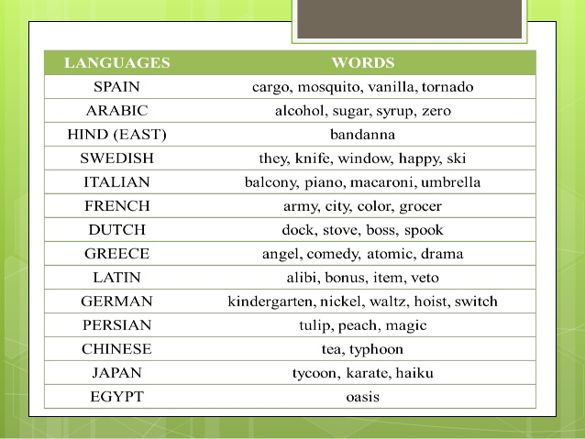
BORROWING WORDS

Slide 31


